Slide 1

Discrete Probability Distributions
J. Alejandro Gelves

Slide 2
Objectives
Understand discrete probability experiments, their outcomes and distributions.
Explore applications to the Binomial, Poisson, and Hypergeometric distributions.

Slide 3
Binomial Distribution
Your favorite team has made it to the final seconds of the 2022 NBA finals. Your team is behind by 2 and your favorite players (a 90% free throw shooter) has three free throws. What is the probability that your team takes the lead? Tie the game?

Slide 4
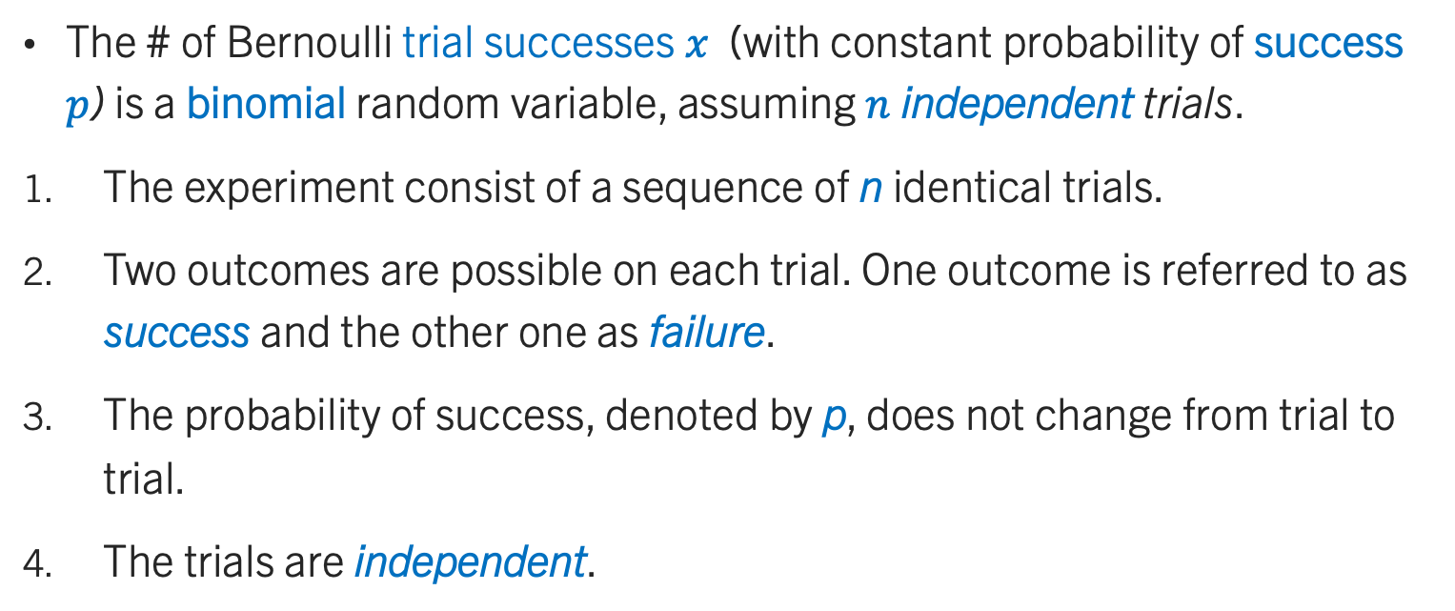
Binomial Experiment
The # of Bernoulli trial successes $x$ (with constant probability of success $p$) is a binomial random variable, assuming $n$ independent trials.
The experiment consist of a sequence of n identical trials.
Two outcomes are possible on each trial. One outcome is referred to as success and the other one as failure.
The probability of success, denoted by p, does not change from trial to trial.
The trials are independent.

Slide 5
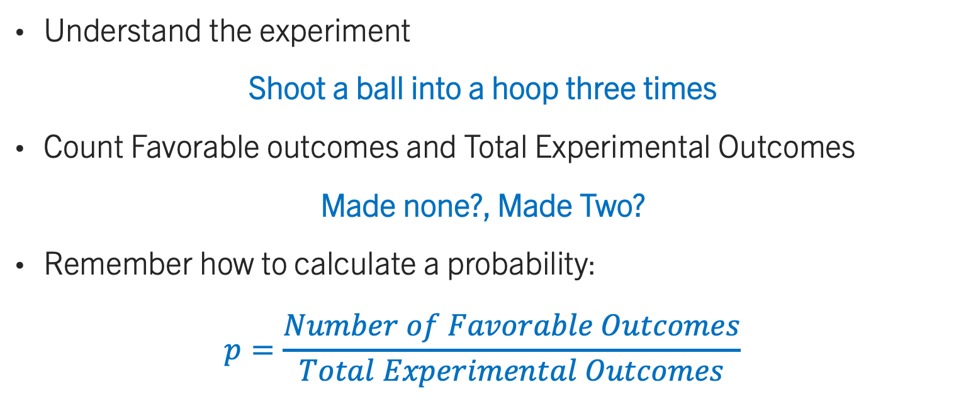
Binomial Experiment
Understand the experiment
Shoot a ball into a hoop three times
Count Favorable outcomes and Total Experimental Outcomes
Made none?, Made Two?
Remember how to calculate a probability:
$$p=\frac{Number of Favorable Outcomes}{Total Experimental Outcomes}$$

Slide 6
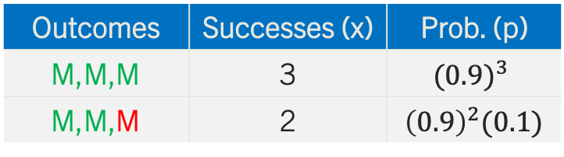
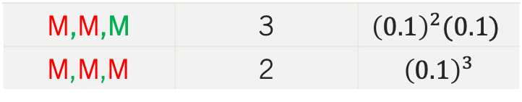
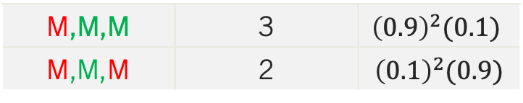
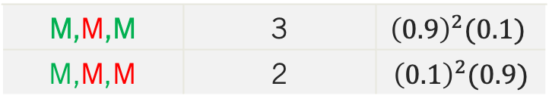
Binomial Experiment
Made
Outcomes | Successes (x) | Prob. (p)
M,M,M | 3 | $${(0.9)}^{3}$$
M,M,M | 2 | $${\left(0.9\right)}^{2}(0.1)$$
0.9
Made
0.9
0.1
Miss
Made
0.9
0.1
M,M,M | 3 | $${\left(0.9\right)}^{2}(0.1)$$
M,M,M | 2 | $${\left(0.1\right)}^{2}(0.9)$$
Made
Miss
0.9
0.1
Miss
Made
0.9
M,M,M | 3 | $${\left(0.9\right)}^{2}(0.1)$$
M,M,M | 2 | $${\left(0.1\right)}^{2}(0.9)$$
0.1
Made
Miss
0.9
0.1
Miss
Made
0.9
0.1
M,M,M | 3 | $${\left(0.1\right)}^{2}(0.1)$$
M,M,M | 2 | $${\left(0.1\right)}^{3}$$
Miss
0.1
Miss

Slide 7
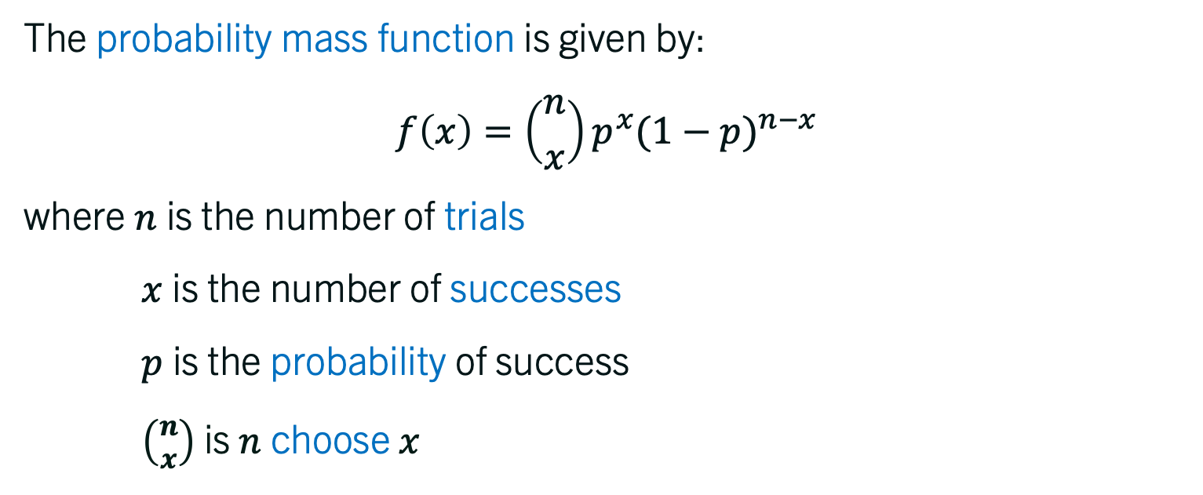
Binomial Probability mass function
The probability mass function is given by:
$$f\left(x\right)=\left({n \atop x}\right)p^{x}{(1−p)}^{n−x}$$
where $n$ is the number of trials
$x$ is the number of successes
$p$ is the probability of success
$\left({n \atop x}\right)$ is $n$ choose $x$

Slide 8
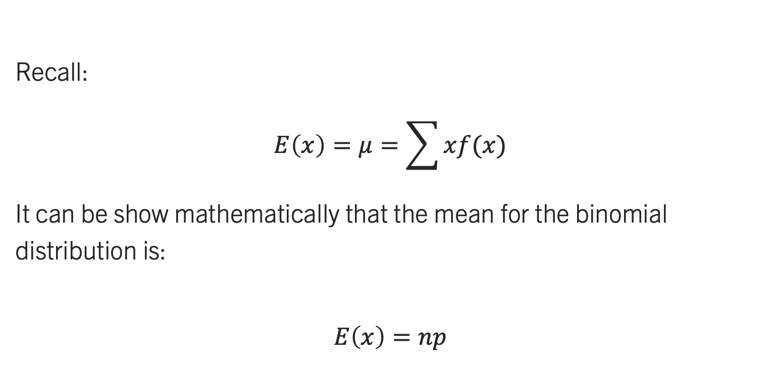
Summarizing Binomial distribution
Recall:
$$E\left(x\right)=μ=\sum{xf(x)}$$
It can be show mathematically that the mean for the binomial distribution is:
$$E\left(x\right)=np$$
Notes:
https://proofwiki.org/wiki/Expectation_of_Binomial_Distribution

Slide 9
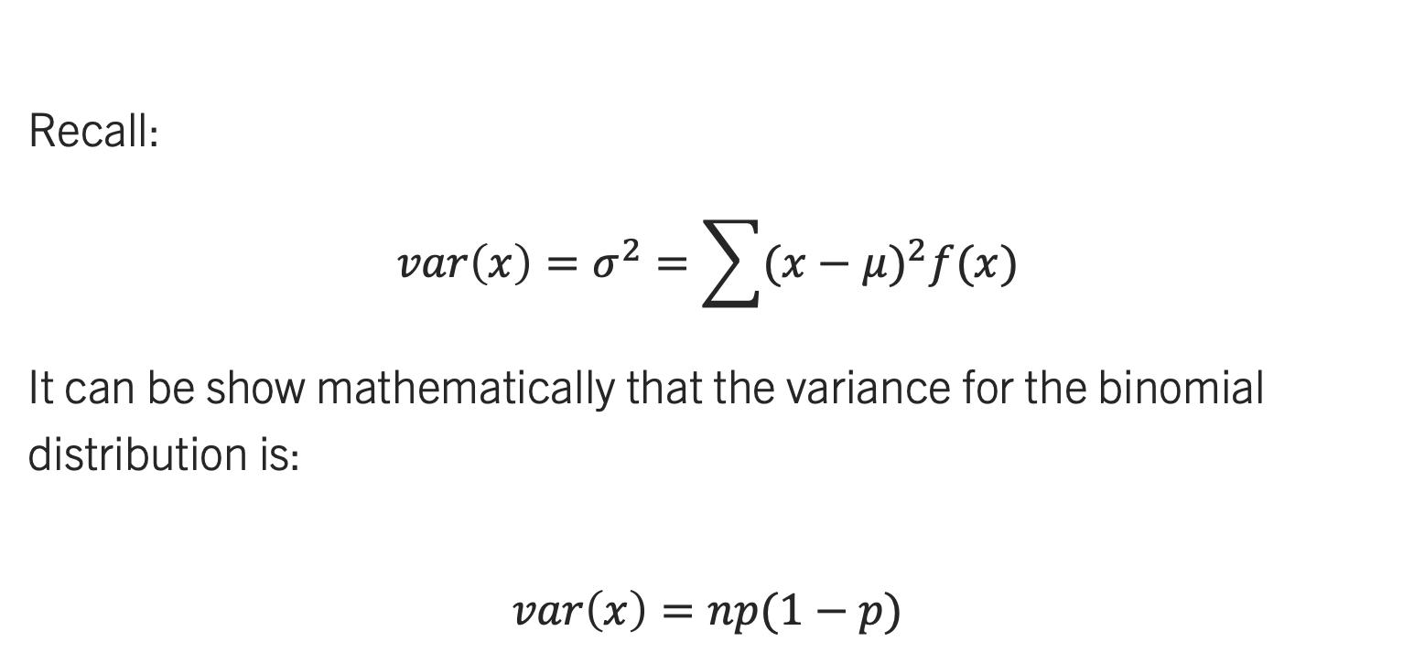
Summarizing Binomial distribution
Recall:
$$var\left(x\right)=σ^{2}=\sum{{(x−μ)}^{2}f(x)}$$
It can be show mathematically that the variance for the binomial distribution is:
$$var\left(x\right)=np(1−p)$$
Notes:
https://proofwiki.org/wiki/Variance_of_Binomial_Distribution

Slide 10
The hypergeometric distribution
Electric fuses produced by Ontario Electric are packaged in boxes of 12 units each. Suppose an inspector randomly selects three of the 12 fuses in a box for testing. If the box contains exactly five defective fuses, what is the probability that the inspector will find exactly one of the three fuses defective?

Slide 11
The hypergeometric distribution
The hypergeometric PMF is used to compute the probability that in a random selection of n elements, selected without replacement, we obtain x elements labeled success and n − x elements labeled failure.
The hypergeometric experiment differs from the binomial since
a) trials are not independent
b) the probability of success changes from trial to trial

Slide 12
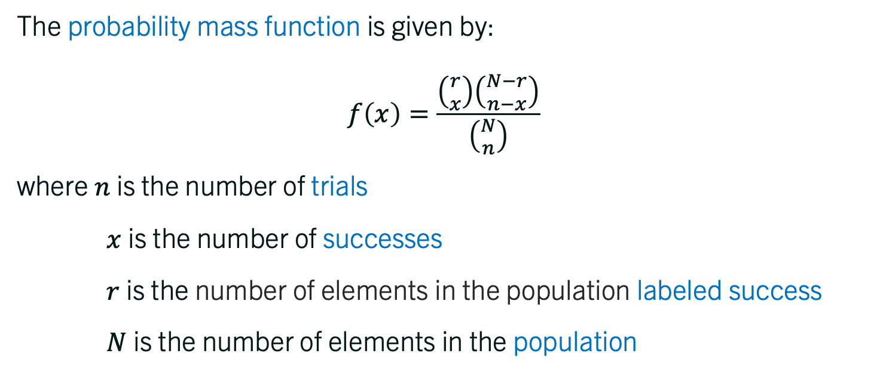
The hypergeometric p.m.f.
The probability mass function is given by:
$$f\left(x\right)=\frac{\left({r \atop x}\right)\left({N−r \atop n−x}\right)}{\left({N \atop n}\right)}$$
where $n$ is the number of trials
$x$ is the number of successes
$r$ is the number of elements in the population labeled success
$N$ is the number of elements in the population

Slide 13
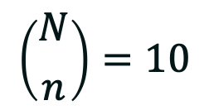
The Intuition behind the p.m.f.
Consider a fuse box that contains 5:
Let the inspector choose three at random:
A
B
C
D
E
…
$$\left({N \atop n}\right)=10$$
A
B
C
A
B
D
D
E
A

Slide 14

The Intuition behind the p.m.f.
3) What is the probability that she selects two that are defective?
A
B
C
D
E
We only have two defective. There is only one possible set
E and C.
$$\left({r \atop x}\right)=\left({2 \atop 2}\right)=1$$
A
E
C

Slide 15
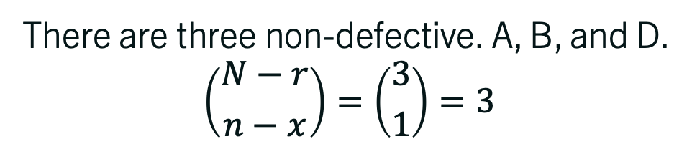
The Intuition behind the p.m.f.
4) We need to complete the sample with one non-defective.
A
B
C
D
E
There are three non-defective. A, B, and D.
$$\left({N−r \atop n−x}\right)=\left({3 \atop 1}\right)=3$$
A
E
C

Slide 16
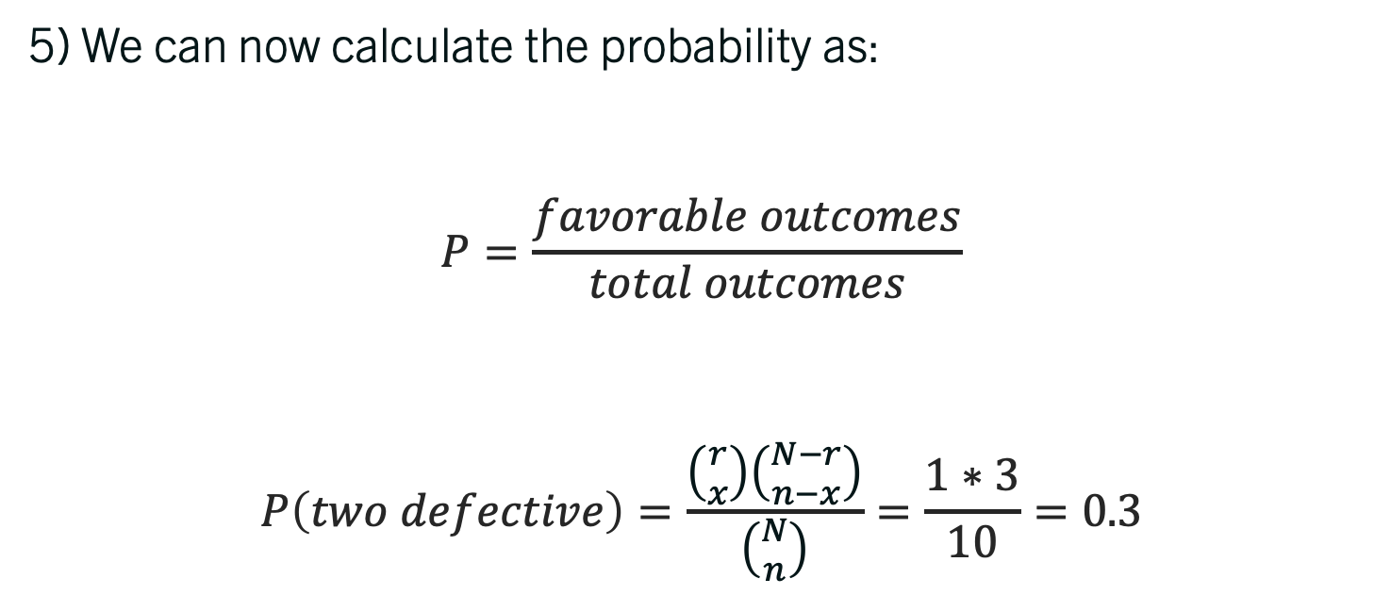
The Intuition behind the p.m.f.
5) We can now calculate the probability as:
$$P=\frac{favorable outcomes}{total outcomes}$$
$$P\left(two defective\right)=\frac{\left({r \atop x}\right)\left({N−r \atop n−x}\right)}{\left({N \atop n}\right)}=\frac{1∗3}{10}=0.3$$

Slide 17

Example Hypergeometric
We take five jellybeans from a box containing 20. There are exactly three licorice jellybeans.
What is the probability that one out of five jellybeans is licorice?
Notes:
Answer: 0.46

Slide 18
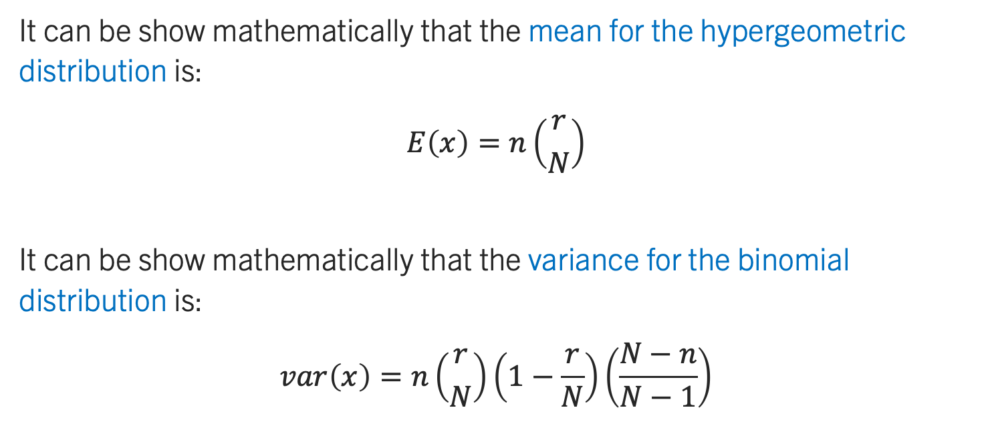
Summarizing the hypergeometric
It can be show mathematically that the mean for the hypergeometric distribution is:
$$E\left(x\right)=n\left({r \atop N}\right)$$
It can be show mathematically that the variance for the binomial distribution is:
$$var\left(x\right)=n\left({r \atop N}\right)\left(1−\frac{r}{N}\right)\left(\frac{N−n}{N−1}\right)$$

Slide 19
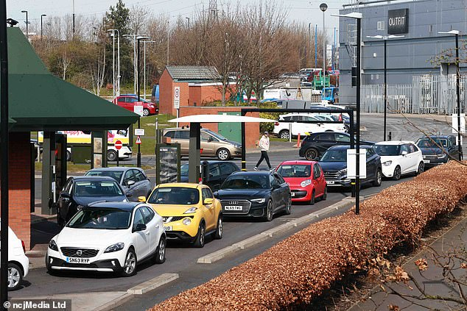
The Poisson distribution
Assume that the number of arrivals at the drive-thru window of a fast-food restaurant during a 15-minute period is on average 10 cars. What is the probability of exactly five arrivals in 15 minutes?
Notes:
Answer: 0.0378

Slide 20
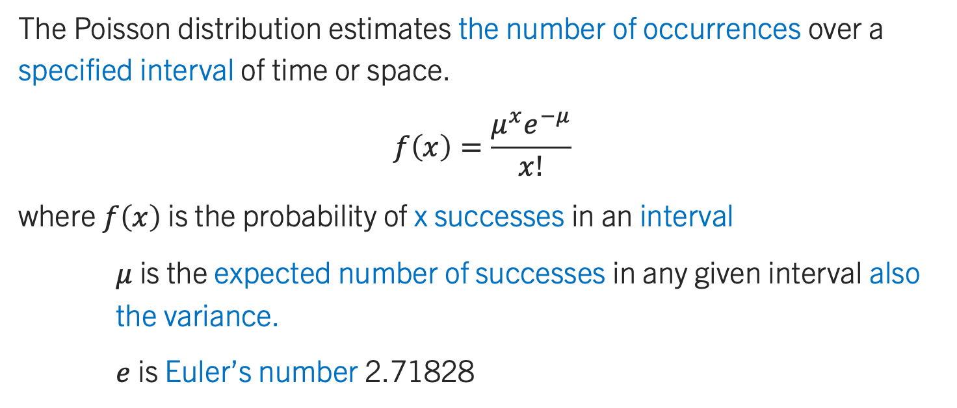
Summarizing the hypergeometric
The Poisson distribution estimates the number of occurrences over a specified interval of time or space.
$$f\left(x\right)=\frac{μ^{x}e^{−μ}}{x!}$$
where $f\left(x\right)$ is the probability of x successes in an interval
$μ$ is the expected number of successes in any given interval also the variance.
$e$ is Euler’s number 2.71828

Slide 21
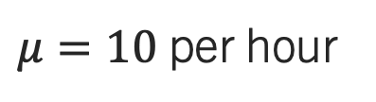
Summarizing the hypergeometric
Six arrivals
1hour
$μ=10$ per hour
“Memoryless”
Eleven arrivals
1hour

Slide 22
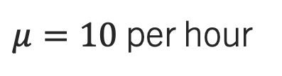
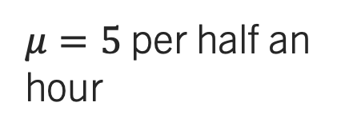
Summarizing the hypergeometric
Eleven arrivals
1hour
$μ=10$ per hour
Four arrivals
½ hour
$μ=5$ per half an hour

Slide 23
the hypergeometric qualities
An experiment satisfies a Poisson process if:
The number of successes with a specified time or space interval equals any integer between zero and infinity
The number of successes counted in nonoverlapping intervals are independent
The probability of success in any interval is the same for all intervals of equal size and is proportional to the size of the interval

Slide 24
The Poisson distribution
What is the probability of exactly five arrivals in 15 minutes? What is the probability of one arrival in 3 minutes? What is the probability of two or more arrivals in 3 minutes?
Notes:
Answers: 0.0378, 0.27, 0.59

Slide 25
Functions in Excel and R

